Slide 1

Puberty
Year 7 Health – 2024
Lesson 7

Slide 2

Today’s focus
Label the female reproductive system.
Define the different parts of the female reproductive system.
Understand the menstrual cycle, symptoms and how to manage it.
Discuss hygiene and how to be hygienic.

Slide 3
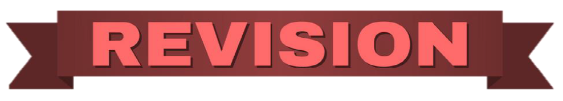
(pg. 57)
In the first 5 minutes of each lesson, you will complete your revision page, you will find these throughout your booklet.
The revision page consists of three questions. It will need to be completed in detail. One-word answers will not be accepted.
The three questions :
What two concepts or ideas did I learn in class last week?
What did I find interesting about last week’s lesson? Provide a specific example.
Any questions or new words you have learnt?
The teacher will go over this each lesson with you to see what you have learnt. It is a great way for you to revisit content and test your memory.

Slide 4
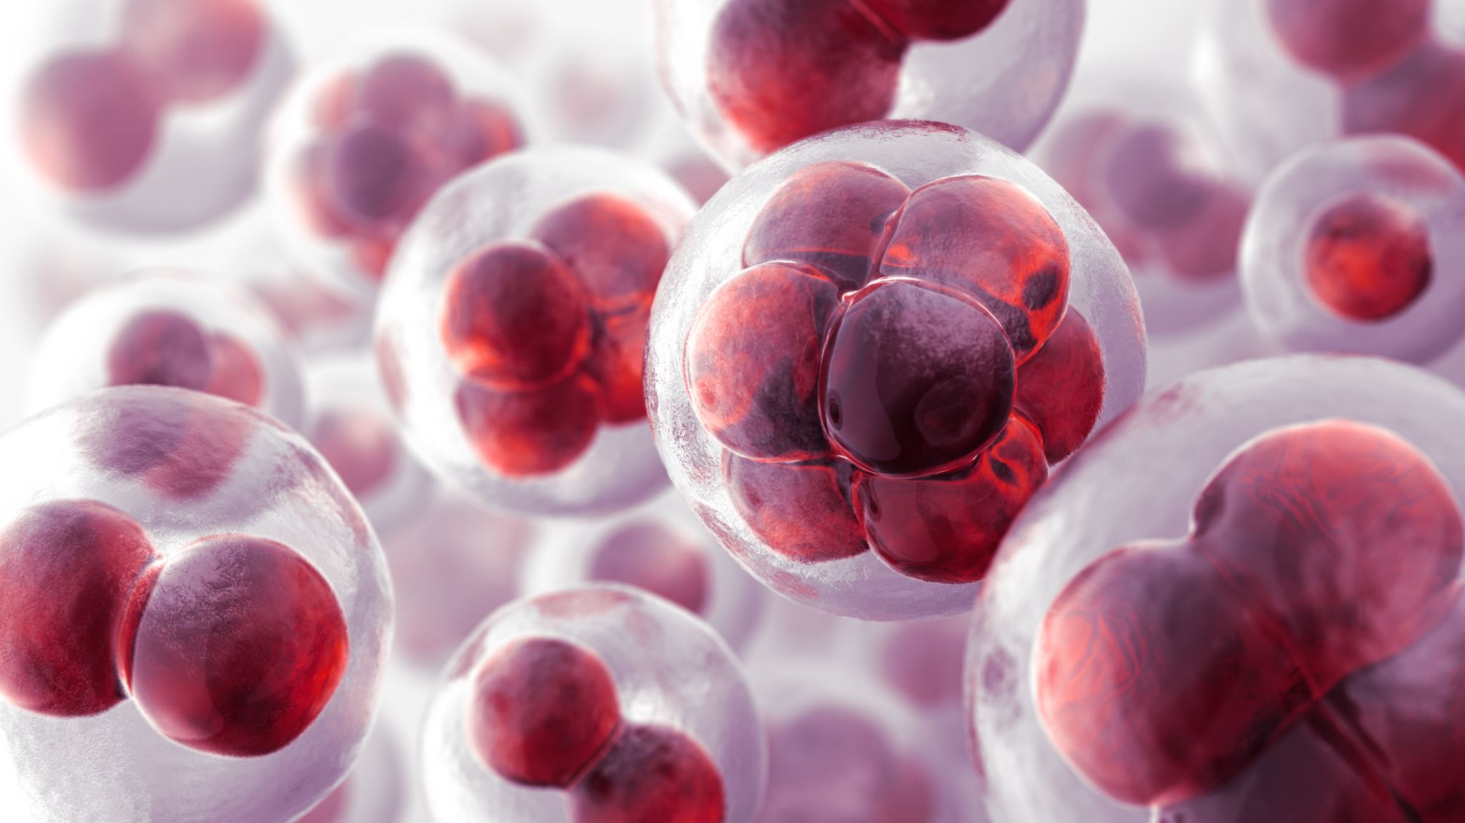
Ovulation & Menstrual Cycle review:
Hormones tell the ovaries to start releasing ova (a.k.a eggs. Singular = ovum, plural = ova).
One egg is released from one ovary each month.
The egg travels through the fallopian tube into the uterus.
In the uterus the endometrium develops a rich blood supply to support a developing baby.
If it is not fertilised by a sperm, then the endometrium leaves the body, through the vagina, through the process of menstruation (a.k.a period).
This cycle is called the menstrual cycle and repeats, on average, every 28 days.
If the egg is fertilised, then it implants into the uterus and a baby will develop.
Notes:
RELEVANT TO TEST
Review. This is not written in their books.

Slide 5

GLOSSARY: (Pg. 5)
At the front of your books is your glossary. Turn to your glossary and add the following words and their definitions:
Premenstrual Syndrome (PMS)
A set of physical, emotional and behavioural symptoms that occur in the 1-2 before menstruation.
Symptoms typically begin in the 5 days before menstruation and end within 4 days after the bleeding starts.

Slide 6
PMS & Period Symptoms (pg.58)
As mentioned, no two people are the same and no two females will have exactly the same experience with their period.
There are some signs and symptoms that may occur before or during a girl's period.
Premenstrual Syndrome, also known as PMS, is a set of physical, emotional and behavioural symptoms that occur during the last week of the luteal phase (1-2 weeks before menstruation). PMS can also be referred to as PMT, or Premenstrual Tension.
PMS symptoms typically start in the 5 days before menstruation begins and ends within 4 days of the bleeding starting.
Notes:
RELEVANT TO TEST
Read through – also in their workbooks.

Slide 7
Activity 1a: PMS & Period Symptoms (pg.58)
If PMS symptoms can be physical, emotional and behavioural… what could they be?
One minute to discuss: what symptoms a female may experience during her menstrual cycle?
Examples of PMS symptoms and period symptoms include:
Ways to manage the symptoms include:
Exercise
Eat well
Get enough sleep
Stress reduction techniques
Pain medication (Panadol, nurofen etc.)
Heat pack
Keeping a diary of symptoms may also be beneficial to keep track of feelings and if things change.
Cramps
Bloating
Acne/pimple breakouts
Breast tenderness
Headaches
Mood swings
Feeling more irritable, upset or anxious
Tiredness or trouble sleeping
Appetite changes
Notes:
Write the examples of PMS into their books and ways to manage.
Possibly worth mentioning:
Take this opportunity to mention that there are conditions related to the female reproductive system:
Endometriosis – affects the endometrium/uterine lining, where the uterine lining grows outside of the uterus. It can cause severe pain and discomfort and impact fertility.
Polycystic Ovarian Syndrome (PCOS) – a hormonal condition which impacts the regularity of the menstrual cycle and fertility, amongst the possibility of other symptoms.
This is why keeping a diary could also be effective if a person starts to experience changes, or more painful or irregular periods as it could be a sign of something else going on.

Slide 8
BONUS QUESTION!
Q: Why is it important for MALES to ALSO be aware of the menstrual cycle, menstruation and PMS?
A: We all have females in our life in some capacity – friends, siblings, family, peers, colleagues, bosses etc.
It can be helpful as it can allow everyone to understand what someone may be going through a little bit better. Periods and PMS can effect everyone differently from person to person, or even from month to month. Females don’t have automatic control over their hormones so navigating all of this can be tricky at times.
The same can be said for females and needing to know about the male reproductive system and male puberty.
It can be a tricky and confusing time for anyone so by increasing our knowledge and understanding can help us to be kinder and more empathetic towards each other, therefore establishing more positive relationships with those around us.
Notes:
Optional to award a prize for the best response to this question.

Slide 9
How to manage Menstruation (pg.59)
Tampons: a small plug of material that fits inside the vagina to absorb blood.
Pro’s: can go swimming, can be more comfortable, available in different sizes, can get tampons with an applicator for easier insertion, easy to pack/transport.
Con’s: takes practice to be able to use one comfortably, needs to be changed regularly, toxic shock syndrome.
Pads: a sanitary pad stuck on the inside of the underwear to absorb and catch the blood.
Pro’s: easy to use, comes in a variety of shapes and sizes, good when learning your cycle.
Con’s: need to be changed regularly, can be uncomfortable, outline and shape can show when wearing tight fitting clothing, can’t swim in them.
Period Underwear: underwear that contains a moisture-wicking fabric to absorb the blood.
Pro’s: environmentally friendly (compared to pads and tampons), easy to use, comfortable, come in different styles and absorbency.
Con’s: must be washed straight away, must buy the correct size.
Menstrual Cup: a small, flexible cup that is inserted into the vagina to catch the blood.
Pro’s: can be used for 8-12 hours at a time, comes in different shapes and sizes, most environmentally friendly method, cost effective, hold more blood than a pad/tampon, easy to use once comfortable, less odour.
Con’s: takes practice to be able to use correctly and comfortably, can take time to find the right fit, removal can be messy, need to be washed after every use.
Notes:
All of this is written in their books for their reference.
Optional resource – use the sanitary kits in the storeroom.
Your choice how much time you spend on this.

Slide 10
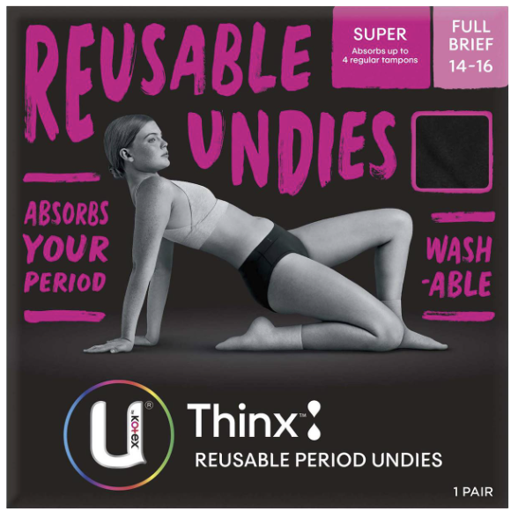
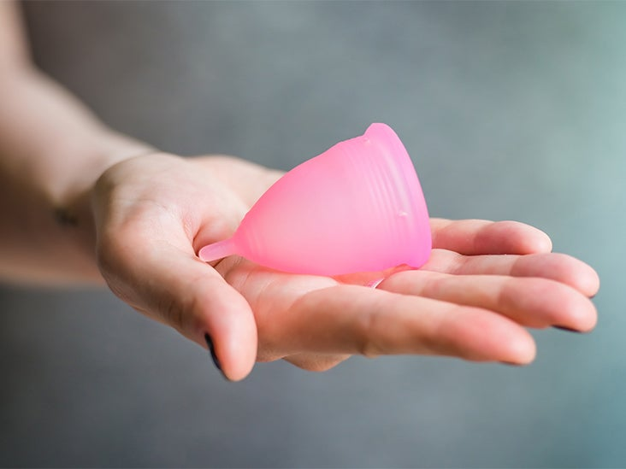
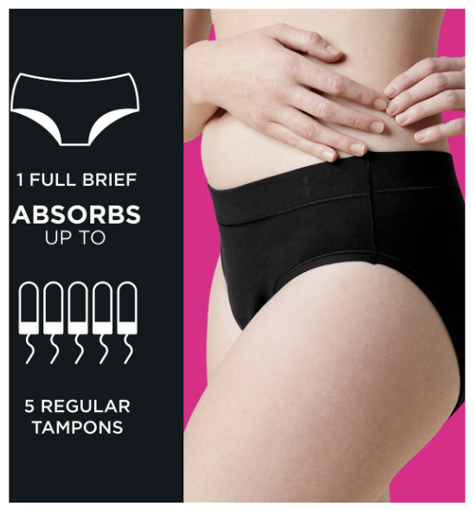
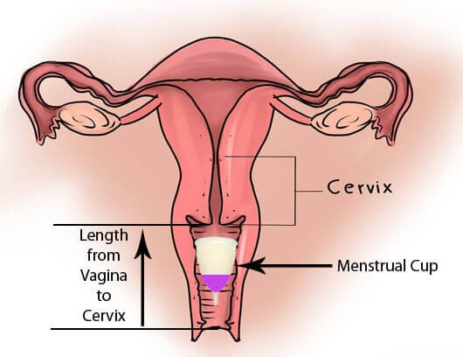
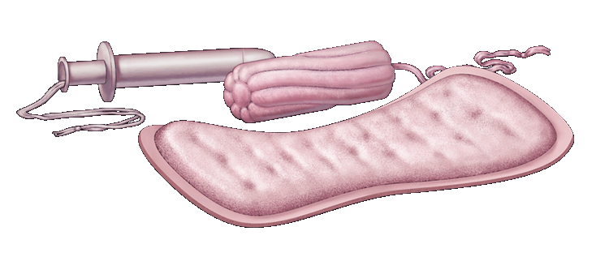
Period Underwear
Menstrual Cups
Tampons
Pads
Notes:
These images are also in their books for their reference.

Slide 11
Activity 1B: MYTH OR FACT? (PG.59)
MYTH = STAND FACT = SIT
A female can’t use a tampon until they’re 17 because their vagina is too small.
You can’t push a tampon so far up that it will get lost in your body.
Tampons cause cancer of the uterus.
A female can feel a tampon when it is worn correctly.
Tampons and pads can be changed depending on flow and comfort.
A person can’t go to the toilet normally when wearing a menstrual cup.
A female can swim while wearing a tampon or a menstrual cup.
Period underwear is a standalone solution for managing menstrual flow.
MYTH
FACT
MYTH
MYTH
FACT
MYTH
FACT
FACT
Notes:
OPTIONAL ACTIVITY

Slide 12
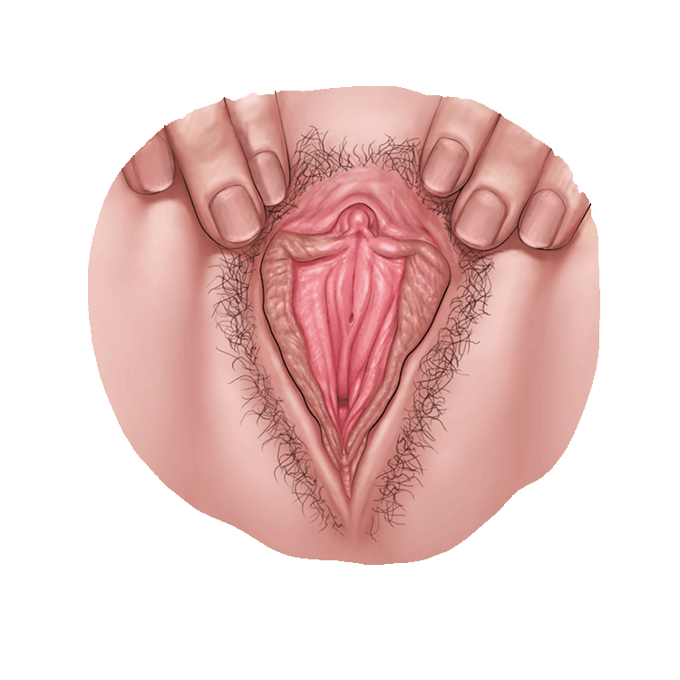
What are the female sex organs?
These parts are also called the reproductive organs and genitals.
The parts on the outside are:
Vulva
The area of soft skin between a female’s legs.
Clitoris
Small organ made of nerves and tissue.
At the top where the lips join.
Only the tip is on the outside, the rest is hidden inside.
Sensitive to touch. Can feel tingly and pleasurable.
Labia
Soft folds of skin that cover the inner parts
Grow darker and bigger at puberty.
Notes:
RELEVANT TO TEST
Read through information.

Slide 13
What are the female sex organs?
Urethra
Not a sex organ.
Tiny opening that urine comes out from the bladder.
Vaginal opening
Entrance to the vagina.
Hymen
Thin piece of skin that may cover part of the opening to the vagina.
Often small or missing.
Anus
Between the two cheeks of the buttocks.
It is where bowel movements come out.
Notes:
RELEVANT TO TEST
Read through information.

Slide 14
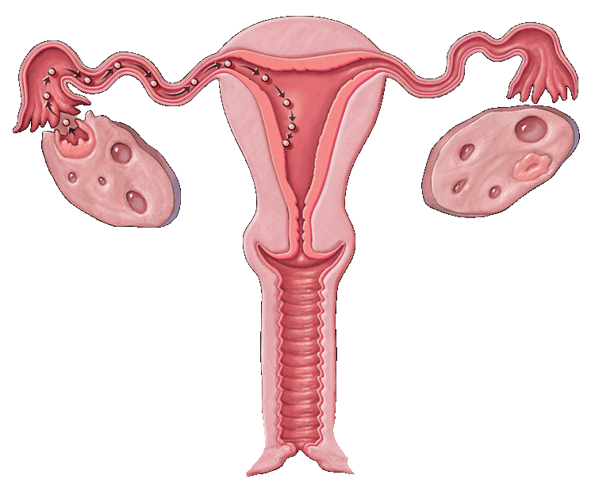
The parts on the inside are…
Uterus
Sometimes called the womb.
Muscular organ about the size of a pear.
Where developing baby, called a fetus, grows and is fed.
Where the period comes from.
Vagina
the muscular tube leading from the external genitals to the cervix of the uterus
Notes:
RELEVANT TO TEST
Read through information.

Slide 15
The parts on the inside are…
Fallopian tubes
Narrow tubes between the uterus and the ovary where the ova travels.
Ovaries
Glands that make egg cells and female sex hormones.
Cervix
The lower part of the uterus.
Makes mucus to keep sperm alive.
Has opening through which menstrual fluid can pass out of the uterus or sperm can enter.
Notes:
RELEVANT TO TEST
Read through information.

Slide 16
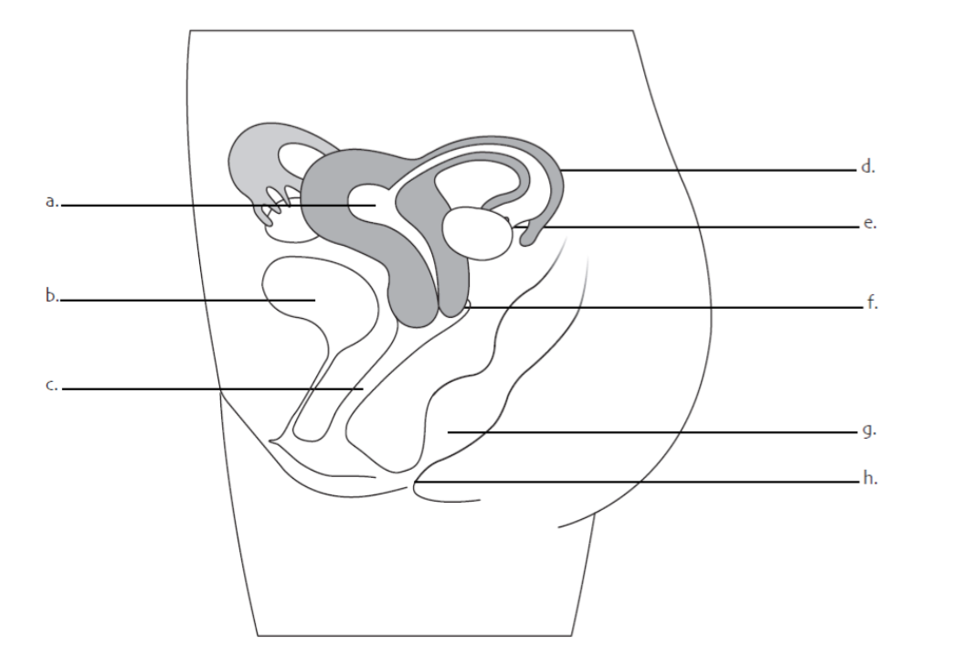
Activity 2: Label the Female Reproductive system (pg.60)
Read the definitions of the female reproductive system in your workbooks.
Use the words to label the diagram of the female reproductive system.
Use your knowledge of the menstrual cycle and the organs involved to help with your labelling.
You have 4 minutes.
Notes:
RELEVANT TO TEST – this diagram will appear in their test.
They should also be aware of the definitions.
There is a FAQ’s page in their workbooks on pg___

Slide 17
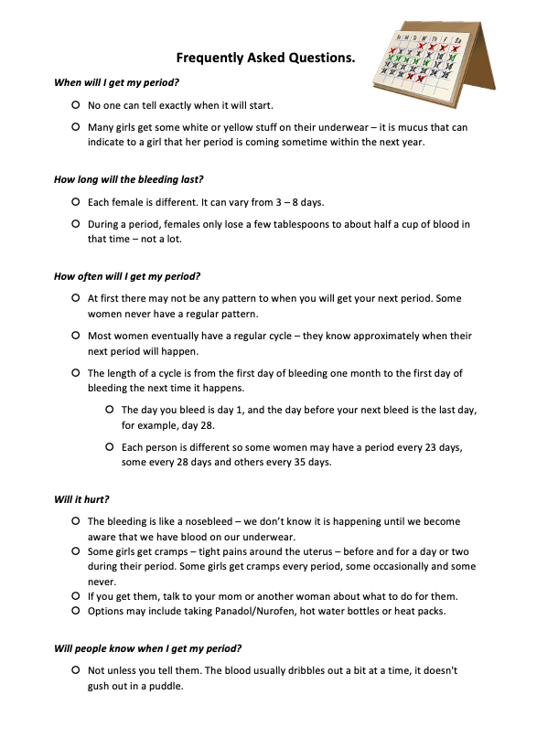
FAQ’s
On page 61 you can find some extra questions and answers related to females and their periods.
Pages 62-65 also contain extra information regarding the menstrual cycle.
Notes:
Students can peruse this in their own time, just make them aware of it.

Slide 18
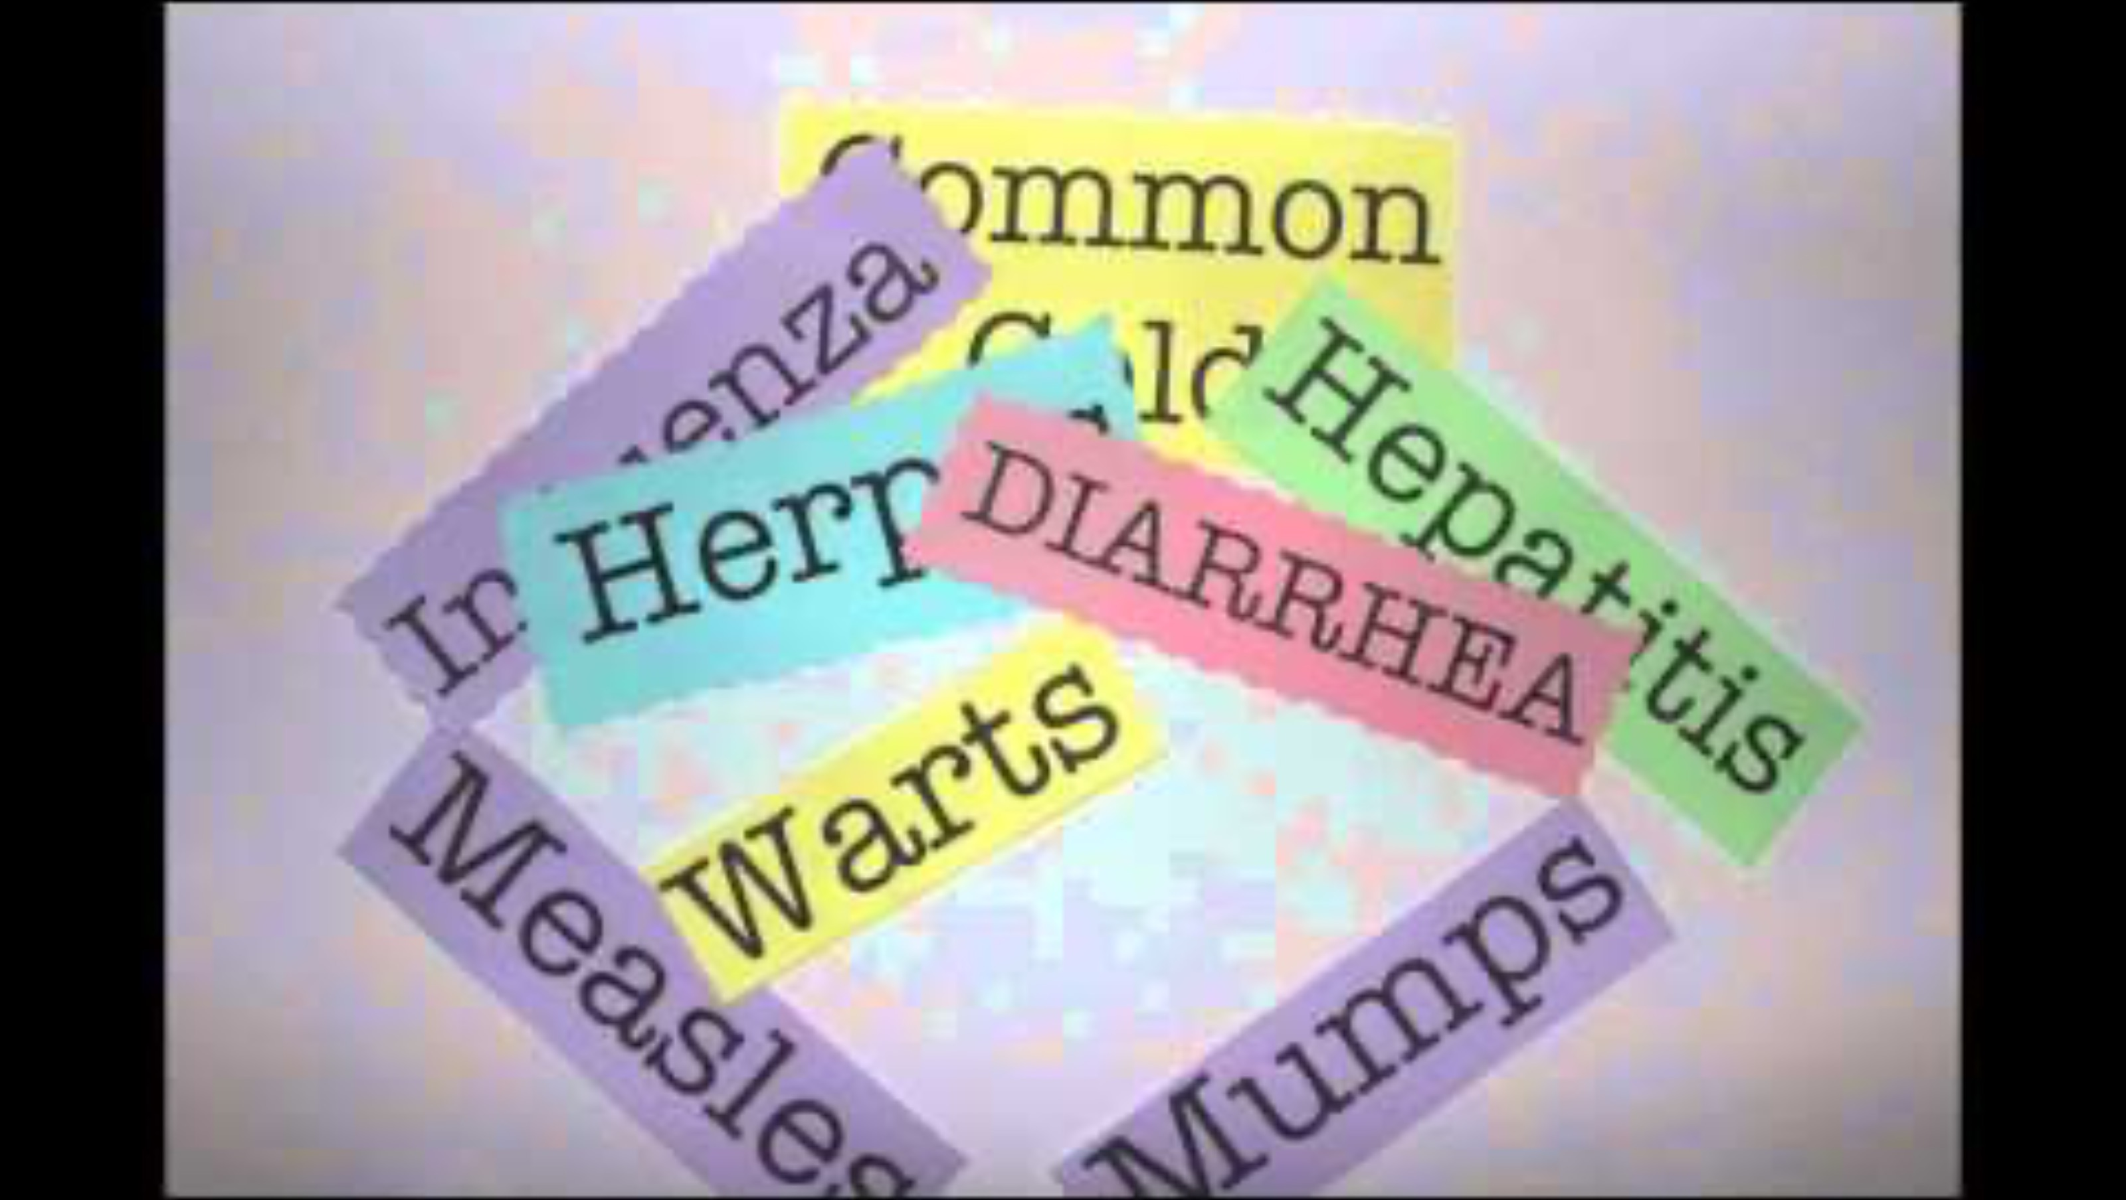
HYGIENE (pg.66)
Maintaining hygiene is important at any stage of life, especially during puberty when our bodies are changing so much.
While watching the video, identify and describe 3 ways you can be hygienic every day.
Notes:
3:57mins
OPTIONAL – can get away with not watching the video.
https://www.youtube.com/watch?v=8ENl6yhTahg

Slide 19
HYGIENE – RAPID FIRE (PG.67-70)
RAPID FIRE!! – Raise your hand to answer:
What are some changes that occur during puberty that could cause hygiene problems for BOTH girls and boys?
What are some hygienic things we can do regularly to help us stay fresh?
Read through the information in your books on pages 67 – 70 and answer the questions.
You have 8 minutes.
Bad breath
Body odour
Increased sweat
Acne/oily skin
Oily hair
Clean our teeth 2x daily
Wear deodorant
Shower daily
Wash our face
Wash our hair
Notes:
Answers for acne self-help strategies on pg.68 are discussed over the next few slides.
Priority pages are pg.67-68 (the first two pages). The other pages are a bit more of a puberty recap (69-70).
Spend whatever time is left of the lesson completing the pages.

Slide 20
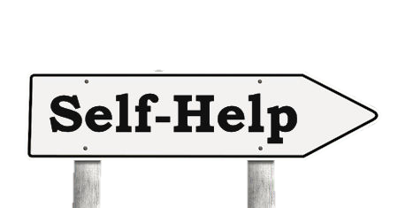
Acne & Self-Help Strategies (pg.68)
How can the following factors effect acne and what can you do to help manage acne?
Washing
Squeezing
Stress
Diet

Slide 21
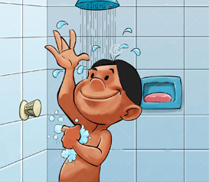
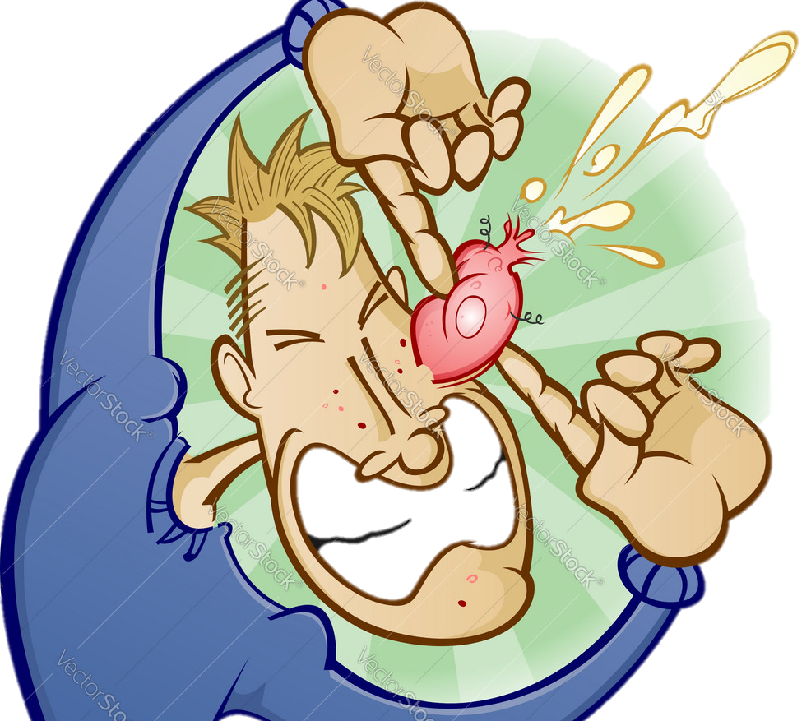
Self-Help: (pg.68) washing & Squeezing
WASHING:
Cleaning the skin can help, but even people with very clean skin can have problems with acne.
Try washing the affected areas twice per day (morning and night).
Don’t overdo it. Too much washing can cause other skin problems, such as dryness or skin irritations.
Try to keep hair clean and off the face and neck, as oil from the hair can make acne worse.
Young people going through puberty don’t need to use lots of expensive products as their skin is still delicate and can be sensitive.
SQUEEZING:
Don’t squeeze!
Picking and squeezing pimples can get germs into the skin around the pimple and make it worse.
It can also lead to scarring of the skin.
Notes:
Help to answer acne self-help questions.

Slide 22
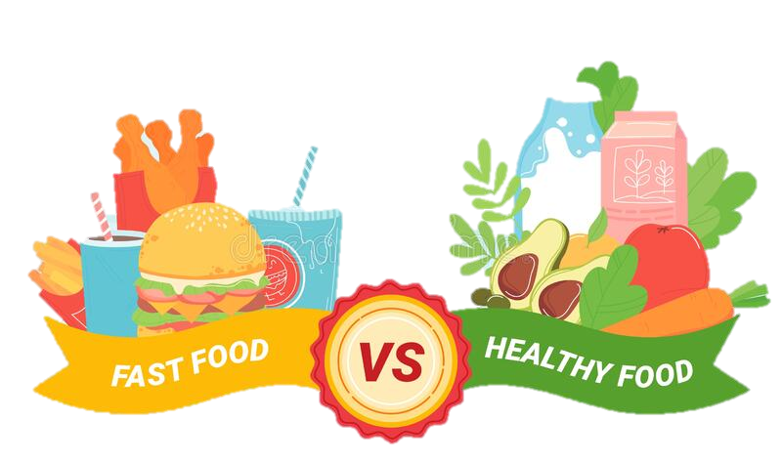
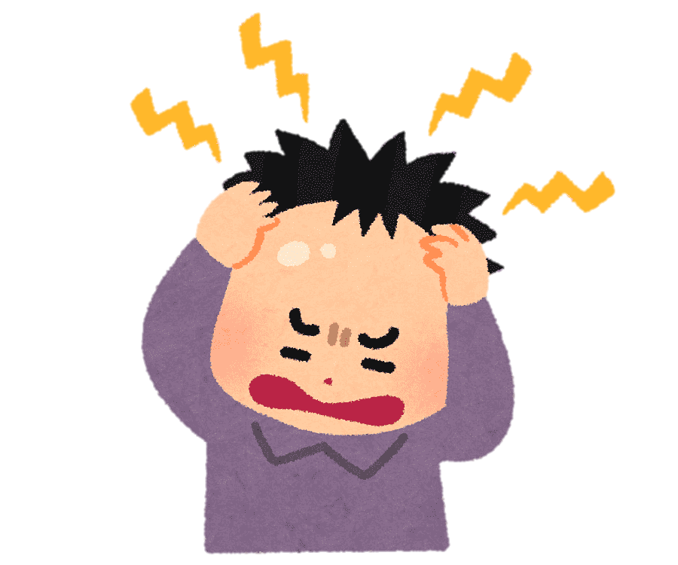
Self-Help: (pg.68) STRESS & DIET
STRESS:
This can trigger an outbreak of pimples as it causes the release of chemicals into the brain that can make oil glands release more oil onto the skin.
This is why pimples seem to magically appear on stressful days, such as at the time of an exam or special date.
While stress may be difficult to control, at least you know that the outbreak is due to stress, not a sign that the treatments do not work.
Try to practice stress management techniques that work for you (e.g. exercise, journaling, meditation etc.)
DIET:
Many people think that lollies or chocolate cause pimples.
Research has not shown any strong link, but some people find that it works this way for them, so if you notice that eating certain foods like chocolate cause pimples for you, try avoiding them.
Notes:
Help to answer acne self-help questions.

Slide 23
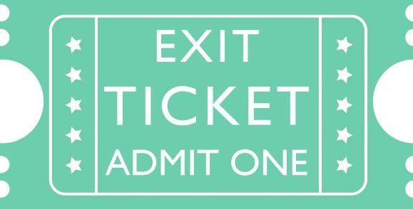
EXIT TICKET:
Turn to your partner and answer the question:
DESCRIBE TWO PARTS OF THE FEMALE REPRODUCTIVE SYSTEM

